Slide 1
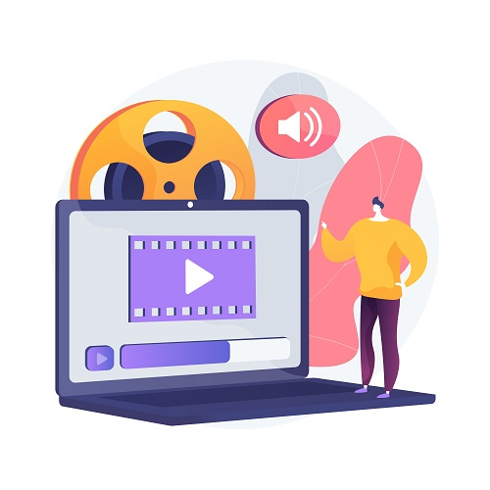
AI-Powered vıdeo translatıon app
Betül Karakuş

Slide 2
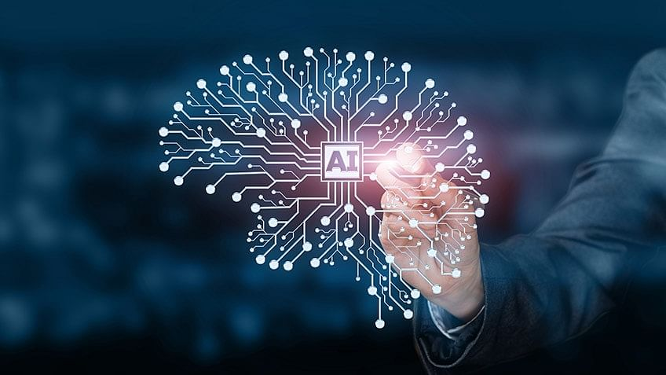
ıNTRODUCTION
Betül Karakuş
Master's student at ODTÜ
AI-powered startup project
Python, Cursor AI, OpenAI Whisper
2

Slide 3
CORE SKILLS
During your UP School education, which 3 social skills (core skills) did you observe the most improvement in?
Considering your group members, which 3 social skills do you think you improved in the most as a group?
From now on, which social skill will you focus on improving?

Slide 4
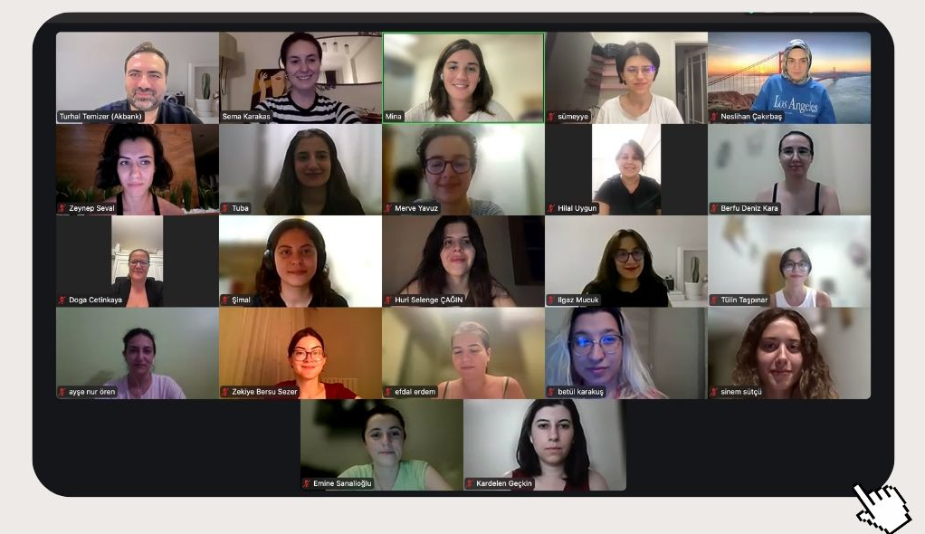
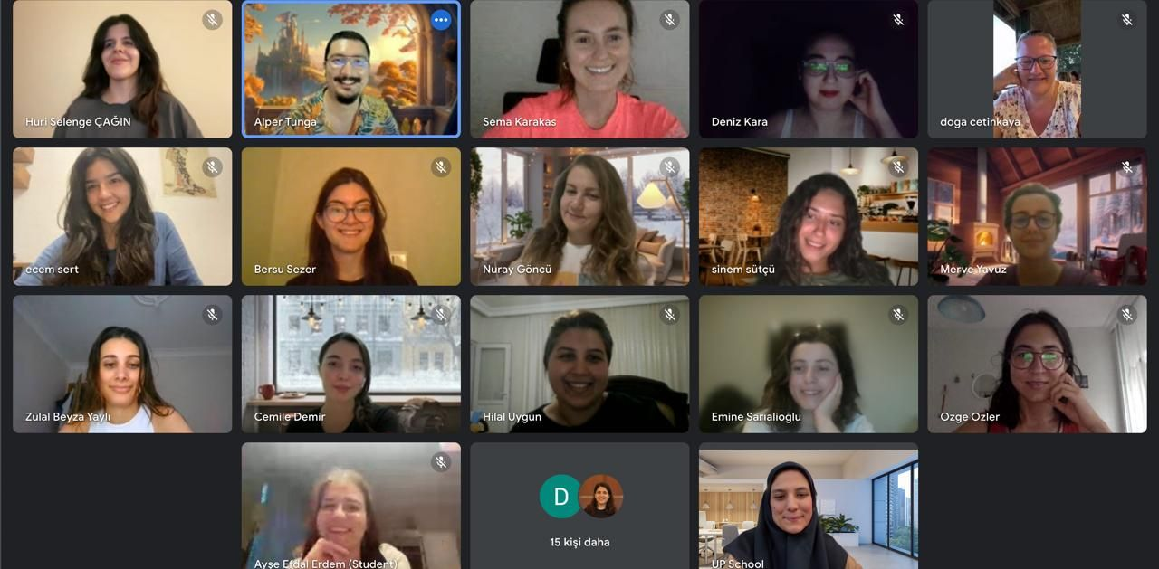
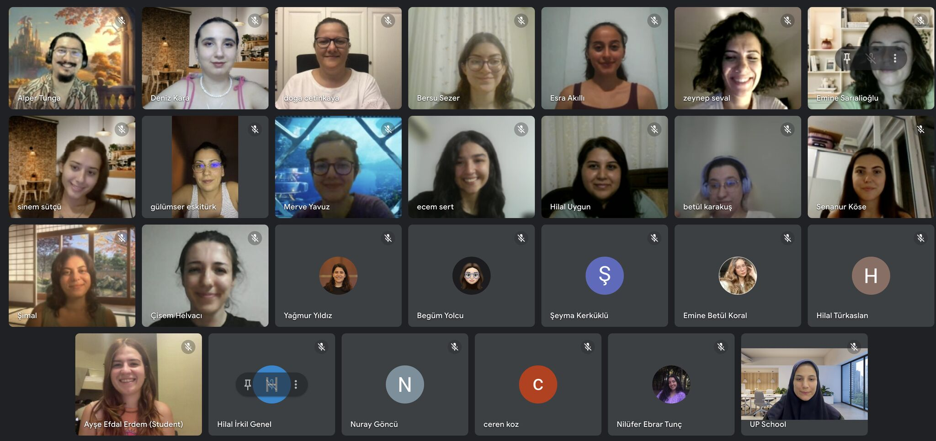
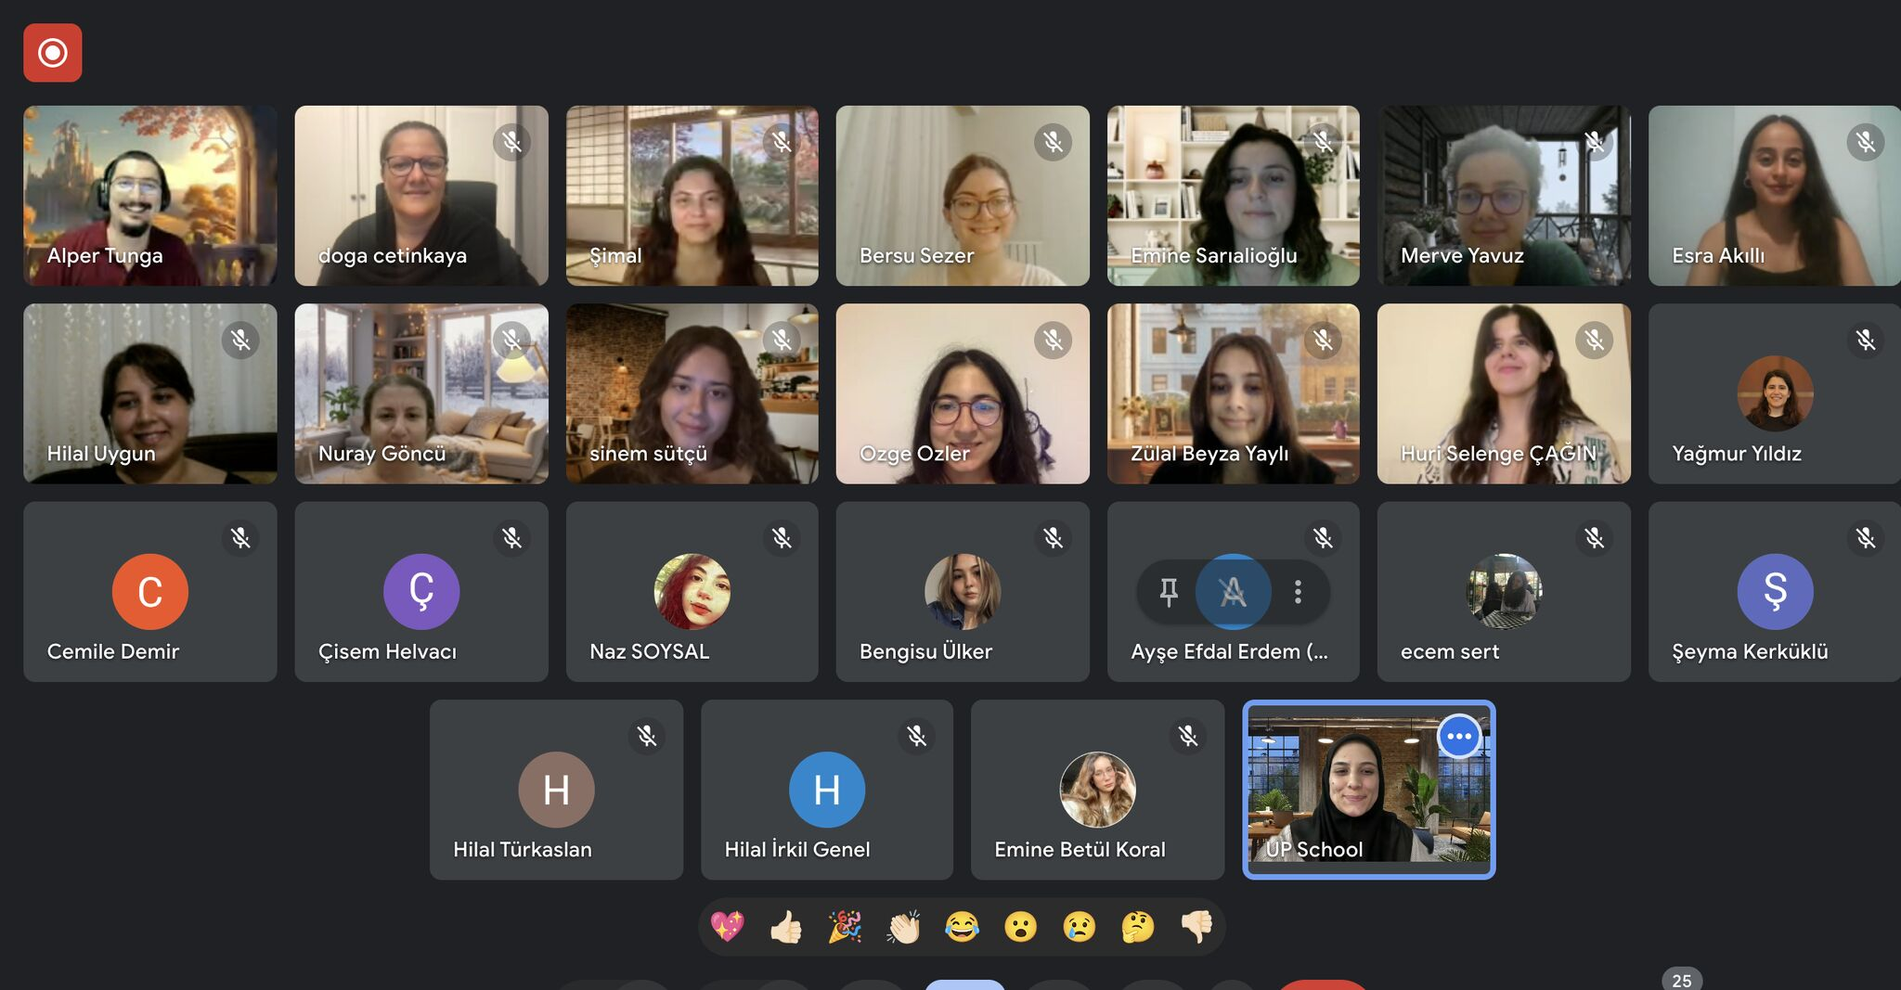



Slide 5
Project overvıew
Video translation into multiple languages
Problem-solving: Multilingual content creation
Converts video to audio, transcribes, and translates
Title: AI-Powered Video Translation App

Slide 6
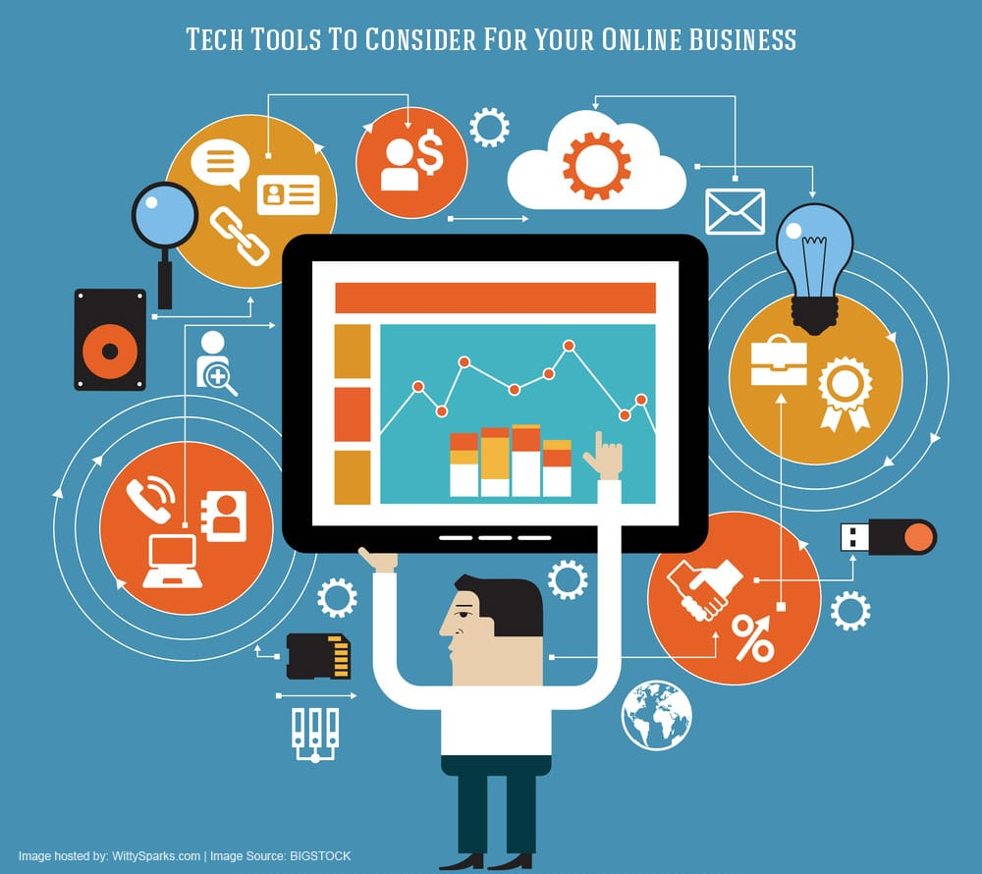

Technology Stack
Python: Core programming language
Streamlit: User-friendly interface
OpenAI Whisper: Speech-to-text model
ChatGPT 4-mini: Multilingual text translation
ffmpeg: Converts video to audio
Cursor AI: Help them code faster and better

Slide 7
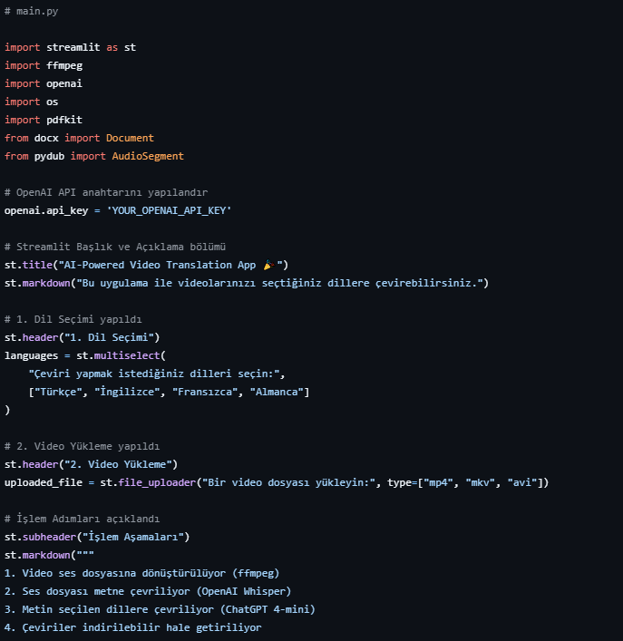
Applıcatıon
User uploads video
Video converted to audio
Transcription and translation displayed
Downloadable file options (TXT, PDF, DOCX)

Slide 8
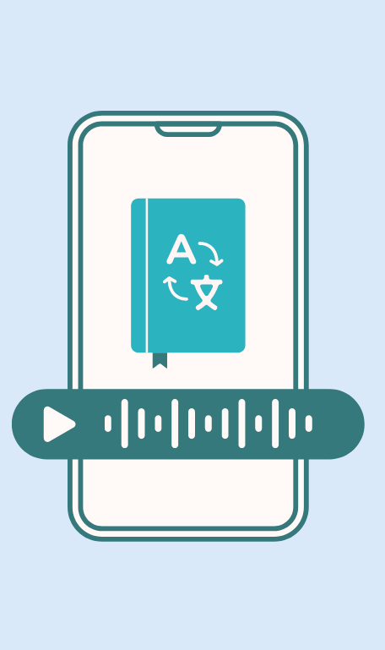
RESULT
Successful multilingual video translation
Future plans: More languages, faster processing
Enhance user experience with more customization
Cloud-based infrastructure integration

